Slide 1

Location Analysis
CS425
Joey Lemon

Slide 2
Introduction
Originally set out to create a way to easily view where I have been
Proposed a web application to analyze location history:
Where does a user spend the most time?
How far has a user traveled?
How often does the user travel?
What kind of travel patterns does the user follow?
Notes:
So this project was originally inspired by the fact that I wanted to have a way to easily view my travel history.
And specifically, I wanted to see a heatmap of my travel overlayed on a map and be able to pan and zoom and all that.
So when we were originally asked to propose a project, I proposed a web application to do that and a little bit more.
The questions this web application sought to answer included:
Where does a user spend the most time?
How far has a user traveled?
How often does the user travel?
What kind of travel patterns does the user follow?
And so this web application was written in React using a couple of different libraries including Google Maps for the map, recharts for the graphs, and a couple of other packages for styling like styled-components and font-awesome and others

Slide 3
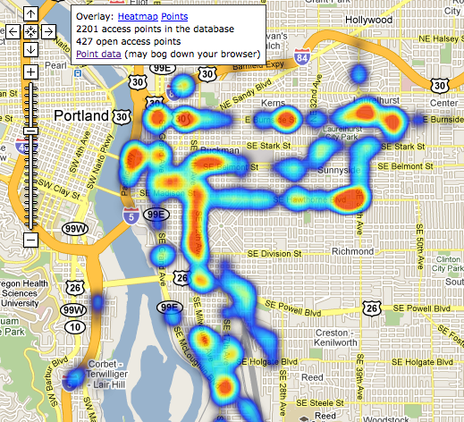
Notes:
And so here’s an example of a heatmap overlayed on a GPS map. So I wanted the web application to have something similar to this.

Slide 4
Data Collection
How will this web application gather the location history of a user?
A mobile application that constantly tracks the user and saves the location pings to a database
Store the pings in AWS
Notes:
So naturally the first question when figuring out how to actually implement this web application is:
How will this web application gather the location history of a user?
And probably the most obvious answer is just to use the user’s phone.
We always carry our phones with us and almost every phone has a built in GPS.
The mobile application is extremely simple and doesn’t even have a user interface so I can’t show you a screenshot of it.
But it’s written for iOS using Swift and uses Apple’s built-in GPS library.
I was able to set up the app to use one of the library methods that lets me define a custom function that will get called every time the user moves a significant amount.
So basically, all the app is a single function that makes an HTTP request with the user’s latitude and longitude in the request body.
And all of these HTTP request location pings are stored in DynamoDB in AWS

Slide 5
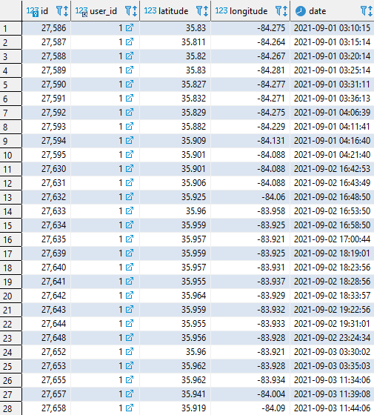
Notes:
Here’s an example of the database structure of the location pings.
You can see it stores the latitude, longitude, and also the timestamp at which it was recorded.
There’s also a unique id column and a user_id column that could be used in the future to store multiple users in the same database if necessary.

Slide 6
Data Preparation
Download the location history from AWS
Upload the file to the web application
Web application handles all the analysis in the background
Notes:
Because I had complete control of the way the mobile app uploads the data to AWS, there isn’t much preparation to do to the data
But originally I wanted the web app to hook directly into AWS and require little interaction from the user to get their data ready
But there wasn’t really a good way to do that without a strong chance of exposing user data and requiring user’s to make accounts or something like that
So I opted for a more reusable approach of making the user download their data into a JSON file from AWS and then using that file within the web app.
Currently, the mobile app uploads the data to a static endpoint and downloading the data from AWS is a little cumbersome.
In the future, maybe the app can be changed to allow the user to specify their own endpoint which would let them use their own database and their own method of downloading the data.
Also in the project’s current state, there isn’t any frontend way of uploading a different JSON file, you’d have to manually switch the file in the filesystem, but the code was written in a way to add that functionality easily later on.
Anyways, when the JSON file is loaded, the web application performs all the analysis in the background and makes it easy for the frontend components to display consumable statistics

Slide 7
Data Analysis
Where does a user spend the most time?
Heatmap with color gradient
How far has a user traveled?
Sum up the distance between location pings
How often does the user travel?
Present a graph showing miles traveled per week
What kind of travel patterns?
Heatmap overlay on map
Notes:
So how does the web application analyze the data and answer the questions I presented a few slides back?
Well, to answer where a user spends the most time, it presents a heatmap with a color gradient, with deep red meaning more time spent there and light green meaning less time.
To answer how far a user has traveled, it presents an information block with the sum of the distances between all the location pings.
To answer how often a user travels, it presents a bar graph with the number of miles traveled for each day of the past week.
And to answer what kind of travel patterns the user follows, again you can view the heatmap overlayed on top of the GPS map and visually observe how the user moves.

